Slide 1
Hi Mathematicians!
I AM ZHIYUE DING, MAGGIE
I am sophomore major in CS and Math.
I am study more math and share what I learned this semester.
Email: zding52@wisc.edu
👩

Slide 2

Differential Equation

Slide 3
HEAT EQUATION
If one area of an otherwise cool metal plate has been heated, say with a torch, over time the temperature of that area will gradually decrease, starting at the edge and moving inward. Meanwhile, the part of the plate outside that region will be getting warmer. Eventually the entire plate will reach a uniform intermediate temperature. In this animation, both height and color are used to show temperature.
SO HARD TO JUST INTEGRATE IT!!!

Slide 4


Slide 5



Slide 6
Finite Difference Method for Differential Equation
To make our lives easier

Slide 7
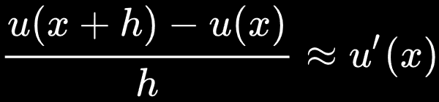
1
Finite difference Method
Finding the slope

Slide 8
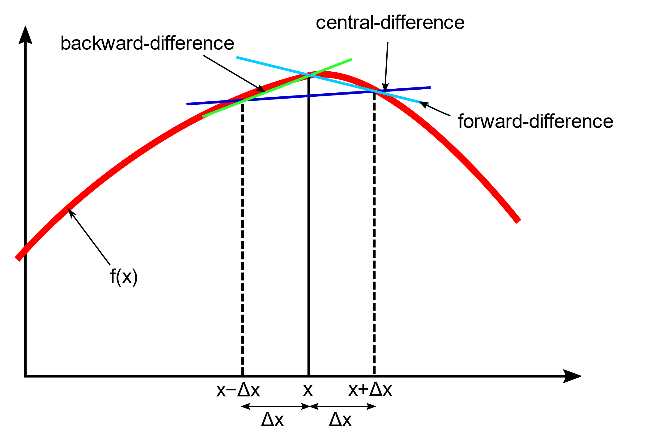
3 types of the finite difference method. Central gives the best approximation of the derivative

Slide 9
First Derivatives

Slide 10
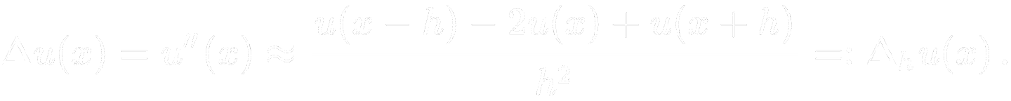
we get Second Derivative from
Taylor Series

Slide 11
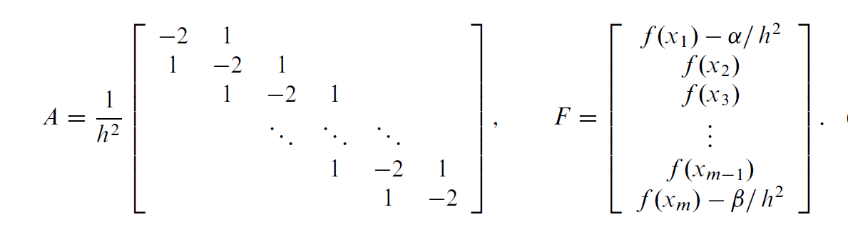

A simple finite difference method

Slide 12
2
Implementation through MATLAB
As a Computer Scientist,
I implement a numerical way to solve differential equation based on finite difference method

Slide 13
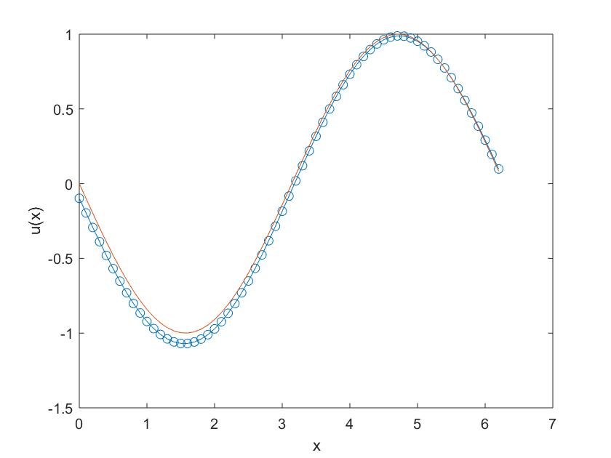

$$U′′\left(x\right)=\sin{x}\text{ [}\text{0}\text{,}\text{2}π\text{]}$$

Slide 14
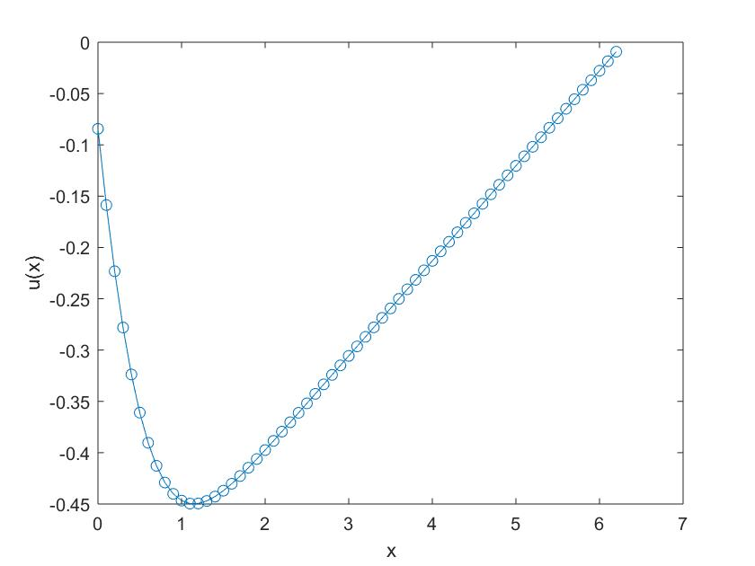

$$U′′\left(x\right)= e^{−x^{2}}\text{ [}\text{0}\text{,}\text{2}π\text{]}$$

Slide 15
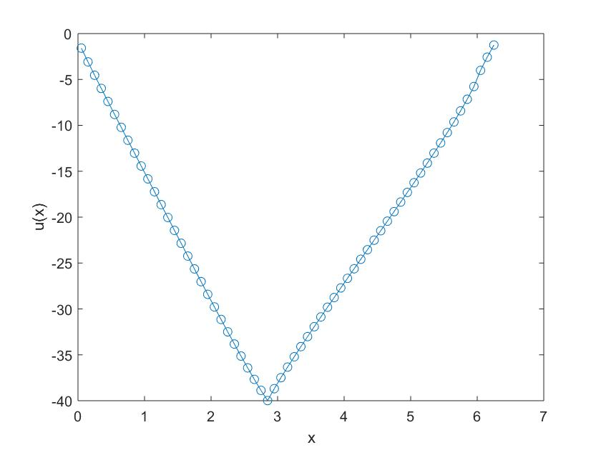

$$U^{′′}={\tan{(x+5})∗{(log}_{e}{x)}}^{\cos{x}} \text{[}\text{0}\text{.}\text{05}\text{,}\text{2}π\text{]}$$

Slide 16

$$U^{′′}=Whatever you could think of$$

Slide 17
Thanks!
ANY QUESTIONS?
Or MATLAB CODE
You can find me at:
zding52@wisc.edu

